Slide 1
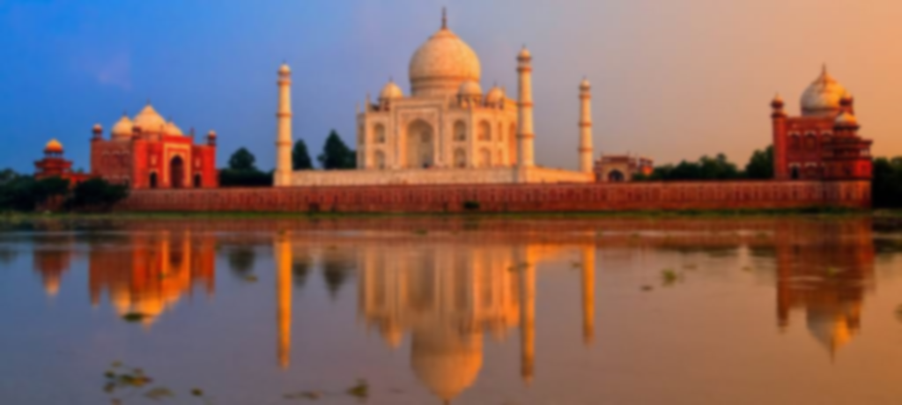
India

Slide 2
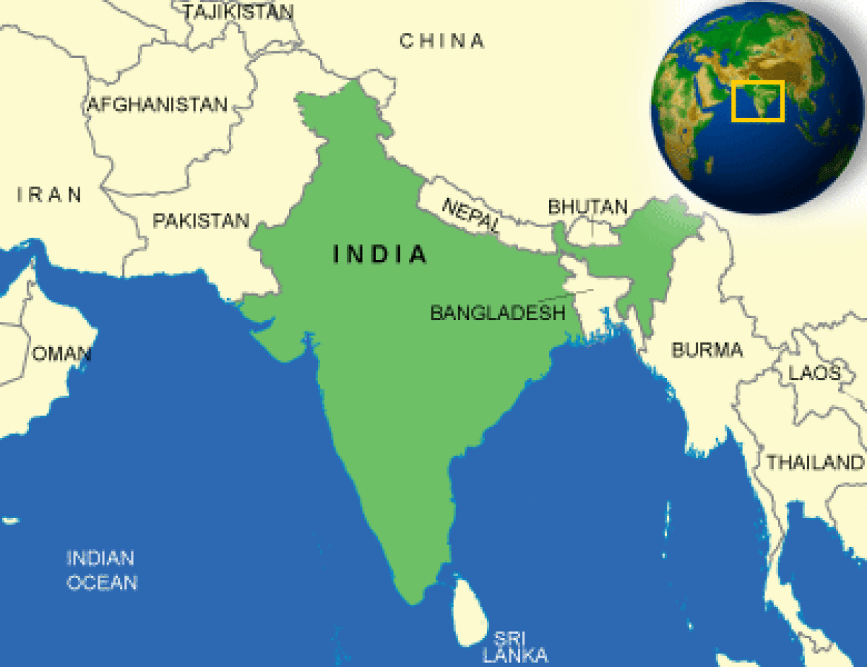
India
From Imperialism to Independence
1813: India was officially declared British territory:
Commercial → Political rule
1876: Queen Victoria was proclaimed Empress of India;
India was considered the “Jewel in the Crown”
1885: Foundation of the Indian National Congress
Difficult relationship between the British and Indians:
Segregation to avoid “native contamination”
During the WWI India contributed men, money and natural resources
Broken promises of Independence
Protests for the extension of the wartime emergency measures
1935: Government of India Act
1947: Proclamation of the Independence of India
Mahatma Gandhi
(non violent rebellion)

Slide 3
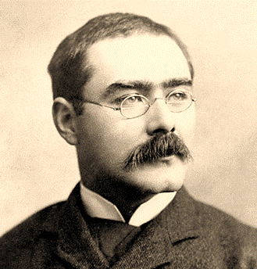
Rudyard Kipling
(1865, Bombay, India - 1936, London, England)
Studied in England as was the custom among Anglo-Indians: he compared the strict rules of English schools to the happy boyhood he had spent in India.
He became an internationally acclaimed writer thanks to his short stories.
Was the first Englishman to win the Nobel Prize for literature in 1907, as an internationally acclaimed writer.
Works:
Plain Tales from the Hills (1888)
Jungle Books (1894-95)
Poem Recessional (1897)
Kim (1901)
Psychological analysis of relations between the British and the Indians.
Abandoned after an accident, baby Mowgli is raised by the animals of the Indian jungle.
Celebration of the British Empire, written in occasion of Victoria’s Diamond Jubilee.

Slide 4
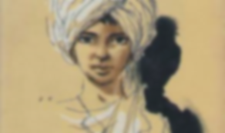
Kim (1901)
Story of an orphan living in India at the time of British rule, son of an Irish but raised by an Indian woman. One day he meets a Tibetan man and he decides to accompany him on his pilgrimage.
Kipling shows India with colourful and passionate descriptions of its sights, sounds and smell, as well as cities filled with people, animals and the Indian luxuriant nature.
Evocative language that fascinates the readers.
The point of view is that of ordinary white men.
«The hot and crowded bazaars blazed with light as they made their way through the press of all the races in Upper India, and the lama mooned through it like a man in a dream.
It was his first experience in a large manufacturing city, and the crowded tram-car with its continually squealing brakes frightened him. Half pushed, half towed, he arrived at the high gate of the Kashmir Serai.»
Strong sense of national identity and superiority over the natives
“White man’s
burden”
Criticised for his jingoism

Slide 5
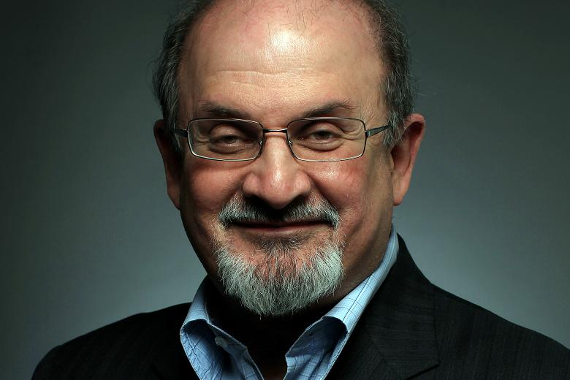
Salman Rushdie
(1947, Bombay, India - )
Middle-class Muslim family.
He studied in England where he got a degree in History at Cambridge University.
In 1964 his family moved to Pakistan joining the exodus during the war between India and Pakistan.
In 1989 he was condemned to death by the Iranian ayatollah Khomeini for his Satanic Verses, reputed sacrilegious by Muslims.
In 2007 he was knighted by Queen Elizabeth II for services for literature.
Works:
Midnight’s Children (1981)
Shame (1983)
The Jaguar smile (1987)
Satanic Verses (1988)
Haroun and the Sea of Stories (1990)
The Ground beneath her Feet (1999)
Fury (2001)
Shalimar the Clown (2005)
Luka and the Fire of Life (2010)

Slide 6

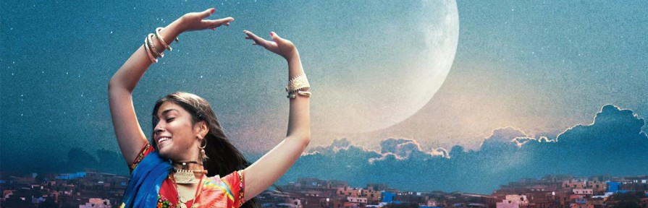
Midnight’s Children (1981)
It’s a comical allegory of Indian history, told with ironical tone, sometimes satirical.
Themes: exile, metamorphosis, rootlessness in the contemporary world.
Magic realism → Rushdie mixed Eastern and Western
language, genres and traditions: fantasy,
mythology, religion and oral tradition.
Novel written in sequences of different styles, using a flexible method known as bricolage (Claude Lévy-Strauss).
The private and familiar is in relation with the political and public.
At the stroke of midnight of 14 August 1947, Nehru announces the Independence of India from England. At that very moment Saleem Sinai (the narrator and protagonist) and other 1000 children are born. All these children have magical features; Saleem has the ability to see into the hearts and minds of men, while his rival (another child named Shiva) has the power of war.
«Saddled now with flypaper-dreams and imaginary ancestors, I am still over a day away from being born… but now the remorseless ticktock reasserts itself: twenty-nine hours to go, twenty-eight, twenty-seven…»

Slide 7
A production by:
Cosentino Marina
D’Angelo Elena
Pistorio Agata
Rapisarda Francesca
Classe V B
Liceo Scientifico Antonino Russo Giusti – Belpasso (CT)
A.S. 2016-2017
Testo di riferimento: Millennium 2 -From the Victorians to the Present (Arturo Cattaneo – Donatella De Flaviis)
C. Signorelli Scuola

