Slide 1
Africa

Slide 2
AFRICA
During the Middle Age: Africa had got well cultivated fields, peaceful villages.
From 16th to 19th: the Atlantic slave trade.
In 19th century, Africa was occupied by European powers:
-religious missions were established.
-schools were founded in which English was taught.
-discovery of gold, diamonds, ivory, rubber, wood and minerals → Exploitation of the “Dark continent”.
After World War II: African diaspora.

Slide 3
CONGO
Henry Stanley completed the exploration of the River Congo→European penetration.
King Leopold II of Belgium announced a different kind of colony, with the intention of bringing benefit to the local populations → Pretext for brutal exploitation.
Société Anonyme Belge , a commercial company, gave Joseph Conrad the possibility to sail up the River Congo.
Joseph Conrad
(Ukraine 1857-England 1924)
His dream was to go to sea and after serving a number of British ships he became a British citizen. When he went to the River Congo he was struck by that place for the rest of his life → He wrote Heart of Darkness.

Slide 4
HEART OF DARKNESS
In Africa, that is the “Dark Continent” , it’s possible to know the impenatrable mistery at the centre of human personality.
When freed from the civilized conventions of European society, the white man is more savage and cruel than the black man he claims he is trying to “civilize”.
Kurtz:
Marlow:
He is the main narrator.
He is fascinated by Kurtz for his courage, and he is disgusted by the other colonists’ hypocrisy.
He justifies colonialism as an important mission for Europeans in Africa, but he degenerates into an amoral and civil conqueror.
Mistah Kurtz- He Dead( Chapter 3)
The last stage of Marlow’s voyage of discovery. Kurtz’s last words are ‘’The horror! The horror!’’ because the last moments of his life represent what he had done during his whole life. Marlow says: “ Perhaps all the wisdom, and all truth, and all sincerity, are just compressed into that inappreciable moment of time in which we step over the threshold of the invisible’’

Slide 5
A scene from Nicolas Roeg’s film version of Heart of Darkness (1994) starring John Malkovich as Kurtz and Tim Roth as Marlow
The book “Heart of Darkness” by Joseph Conrad.

Slide 6
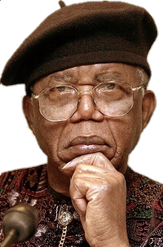
CHINUA ACHEBE (b.1930)
He is famous for his “Ibo trilogy”: Things Fall Apart(1958), No Longer at Ease (1960) and Arrow of God(1964).
The main theme is the conflict between two different cultures.
Things Fall Apart
“Things Fall Apart” is set in the Ibo Village of Mbanta in the late 1880s. Six Christian missionaries go to the village to convert the Ibo men to their religion. Five are black and one is white. In fact it is the white man who stirs the villagers’ curiosity. The missionaries celebrate God and Jesu Kristim asking the villagers to renounce their “false” gods. The people of village disagree with their religious ideals.

Slide 7
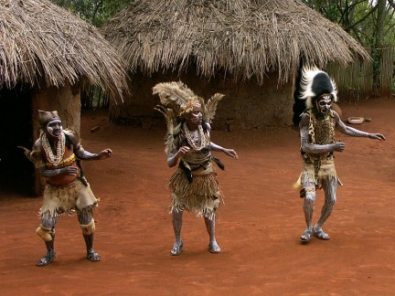
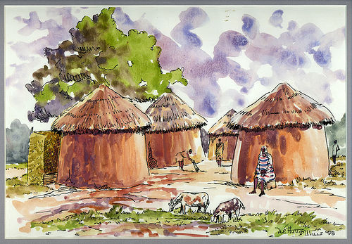
The Arrival of Missionaries
The passage testifies the fusion of African oral tradition made up of rich imagery and proverbs and Western ideologies and Christian doctrines.
“All the gods you have named are not gods at all. They are gods of deceit who tell you to kill your fellows and destroy innocent children. There is only one true God and He has the earth, the sky, you and me and all of us.”

Slide 8
Made by:
-Calvo Francesca
-Carchiolo Agnese
-Marletta Rita
-Oteri Graziella
Anno Scolastico 2016/2017
Classe V sezB scientifico
Sources:
Cattaneo-De Flaviis, Millennium, Signorelli.
Google immagini.

