Slide 1
Poets Tennyson and Eliot

Slide 2
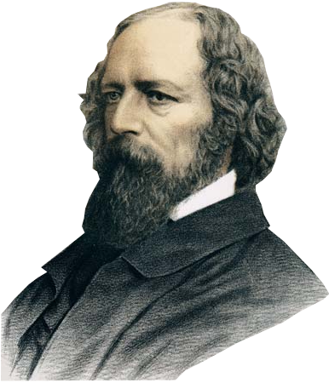
Alfred Tennyson (1809 – 1892)
Alfred Tennyson’s poetry developed at Cambridge through contact with the Apostles, a group of writers guided by Arthur Hallam.
His sudden death traumatized Tennyson who wrote In Memoriam, a series of lyrics that brought him national fame.
Tennyson’s Poetry
Sensations
He combined Romantic motifs with a classical atmosphere
Pessimism
Main themes: regret and loss
Tennyson gives voice to love for adventures and a passionate idea of life
Rendering the impact of the physical world of the senses
His subjects are often taken from the past (as the Homeric Ulysses), revived through immagination: dreaming is an escape

Slide 3
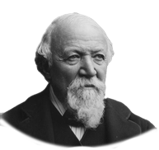
Dramatic Monologue:
poem set in a precise historical and geographical background;
recited by a first-person speaker who tells about crucial moment of his own life;
there is a silent listener;
the language is colloquial.
the character’s moral faults emerge from the situation
The best use of this form was by the Victorian poet Robert Browning. In My Last Duchess the ‘actor’ of the monologue is an imaginary Duke from the Italian Renaissance who tells about his late wife, whose murder was ordered by the Duke himself because her good manners to everybody seemed to him an insult to his social rank.
Browning used unconventional language and he believed that personality is a multiplicity of selves
He exerted a great influence on early 20th-century modernist poetry.

Slide 4
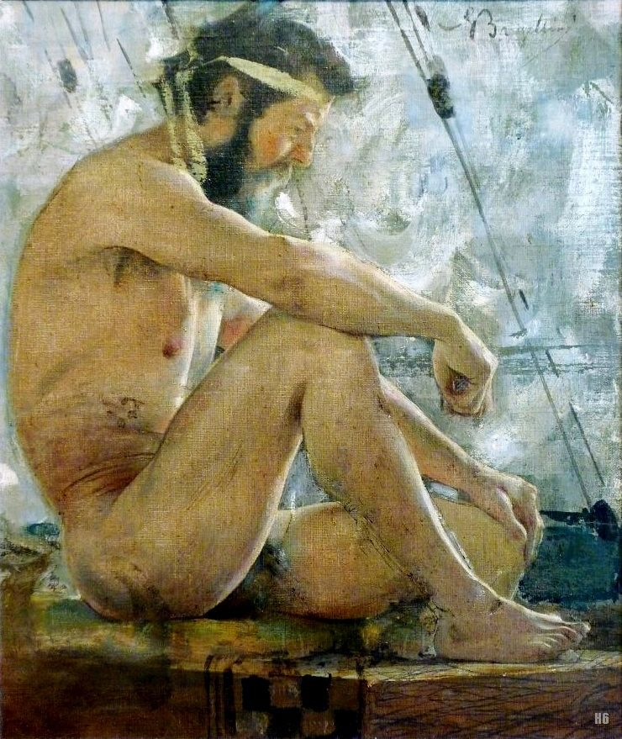
Tennyson’s Ulysses (1842)
In this dramatic monologue Ulysses cannot accept the monotonous life at Ithaca:
Like Homer’s Ulysses, he is a restless spirit,
ever open to new experience;
he finds the meaning of life in continuous movement to pass the unknown
«And this gray spirit yearning in desire To follow knowledge like a sinking star, Beyond the utmost bound of human thought»
«For always roaming with a hungry hearth.»
Like Dante’s Ulysses, endless searching becomes a dangerous desire for forbidden experience
«I will drink Life to the lees.»
«One equal temper of heroic hearts, Made weak by time and fate, but strong in will To strive, to seek, to find, and not to yield.»
The poem can be read as Tennyson’s opposition to Victorian decorum
G. Bargellini, Ulisse

Slide 5
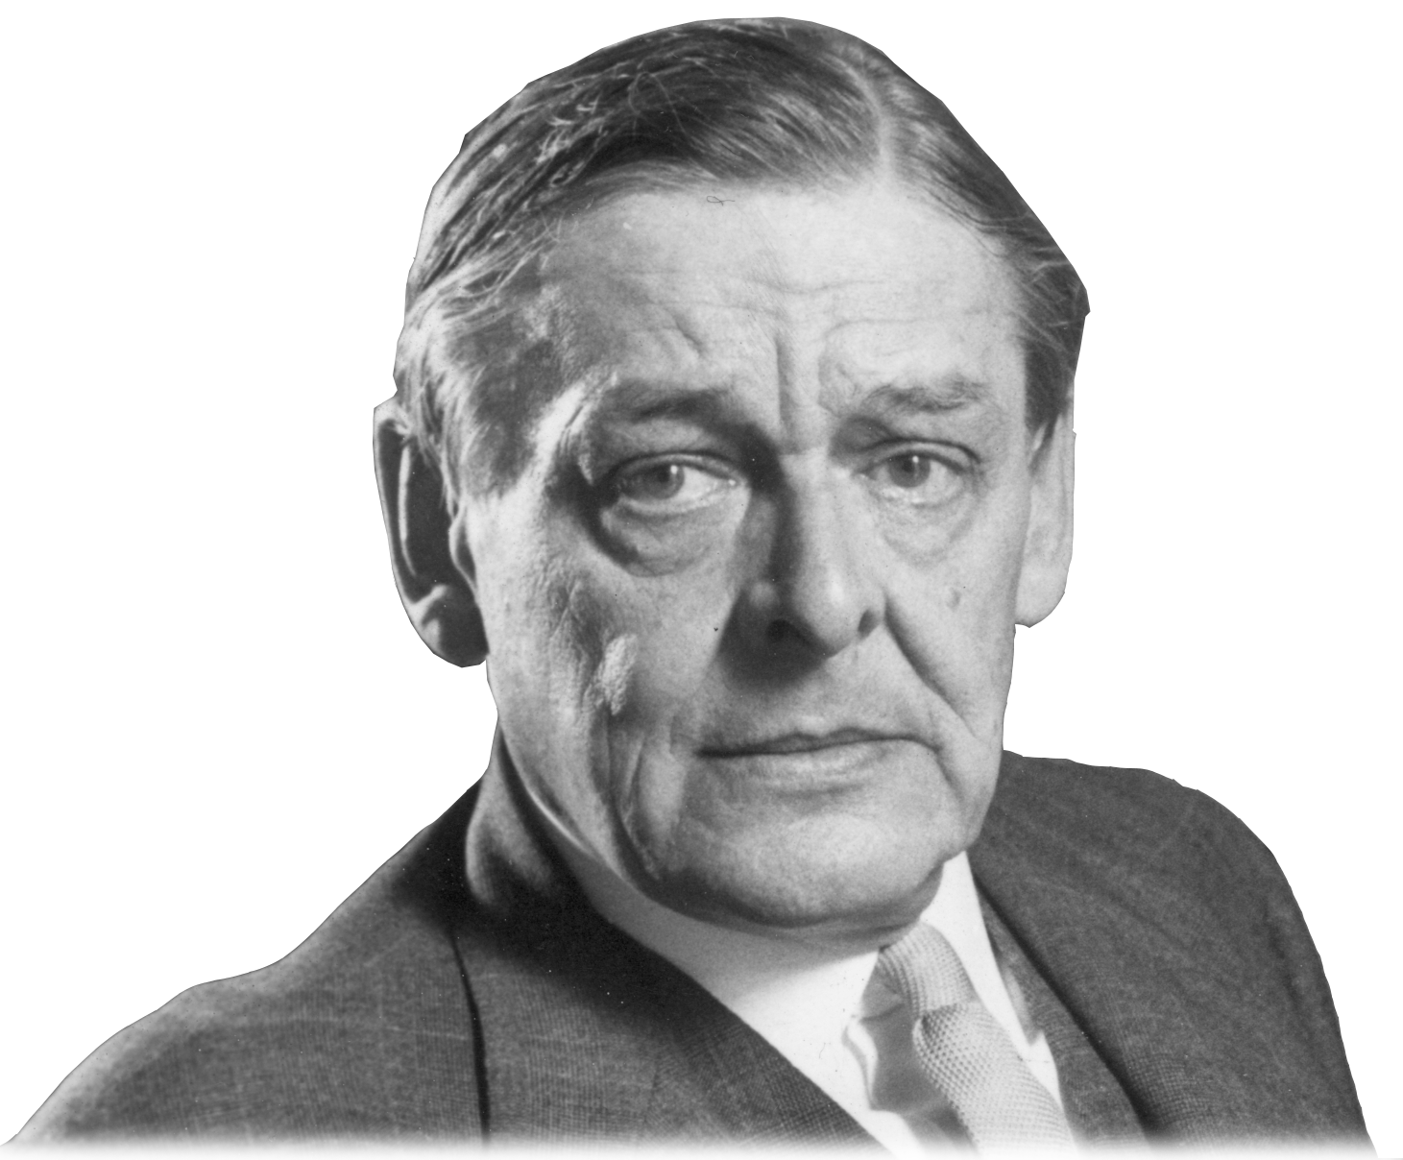
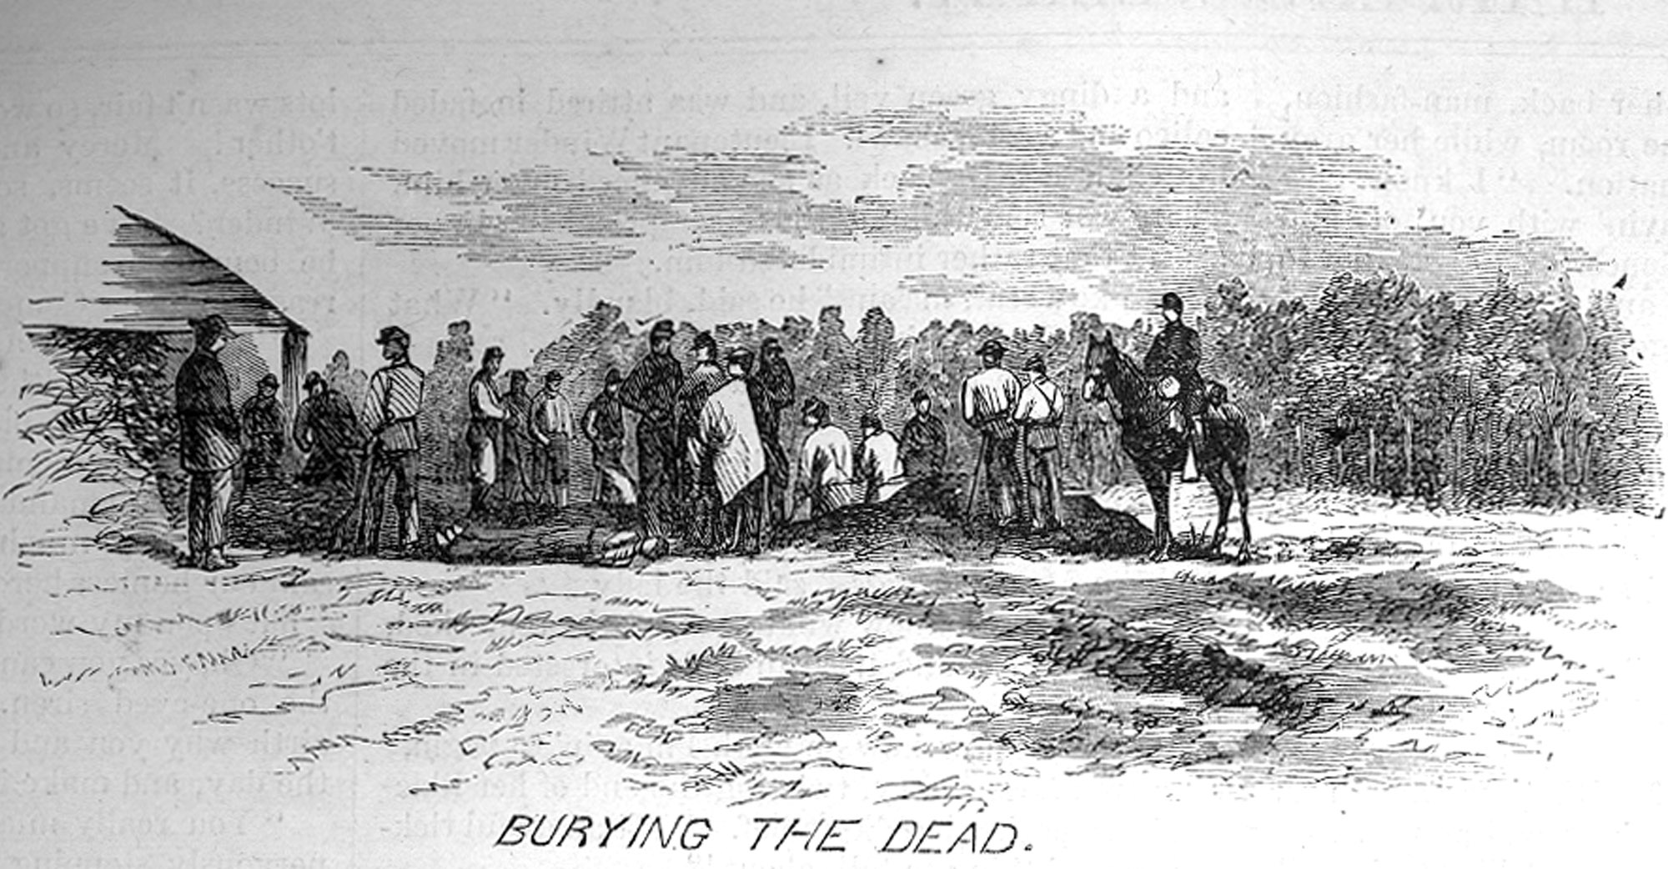
Thomas Stearns Eliot (1888-1965)
He was born in the United States but lived in Europe.
The American poet Ezra Pound exerted an enourmous literary influence on him.
During the 30s he found a way out of nihilism toward Christian faith.
The I phase of Eliot’s career was influenced by NIHILISM:
After World War II Eliot was occupied with drama, criticism and reviewing.
In 1948 he received Nobel prize in literature.
The Waste Land (1922)
It expresses the modern artist’s disillusion with the world.
The poets see only ruin
and desolation around them.
the most important Modernist poem;
divided in five sections characterized by:
Fragmentation of structure;
He was interested in aspects of the decay
of western civilization after WWI.
Use of images, echoes and quotations from religious and philosophical tradition;
«The Burial of the Dead»
«A Game of Chess»
«The Fire Sermon»
«Death by Water»
«What the Thunder Said»
Complex language with use of stream of consciousness technique;
Mythical method;
Metrical pattern: lines vary in length and rhythm, so there are both free and regular verses.

Slide 6
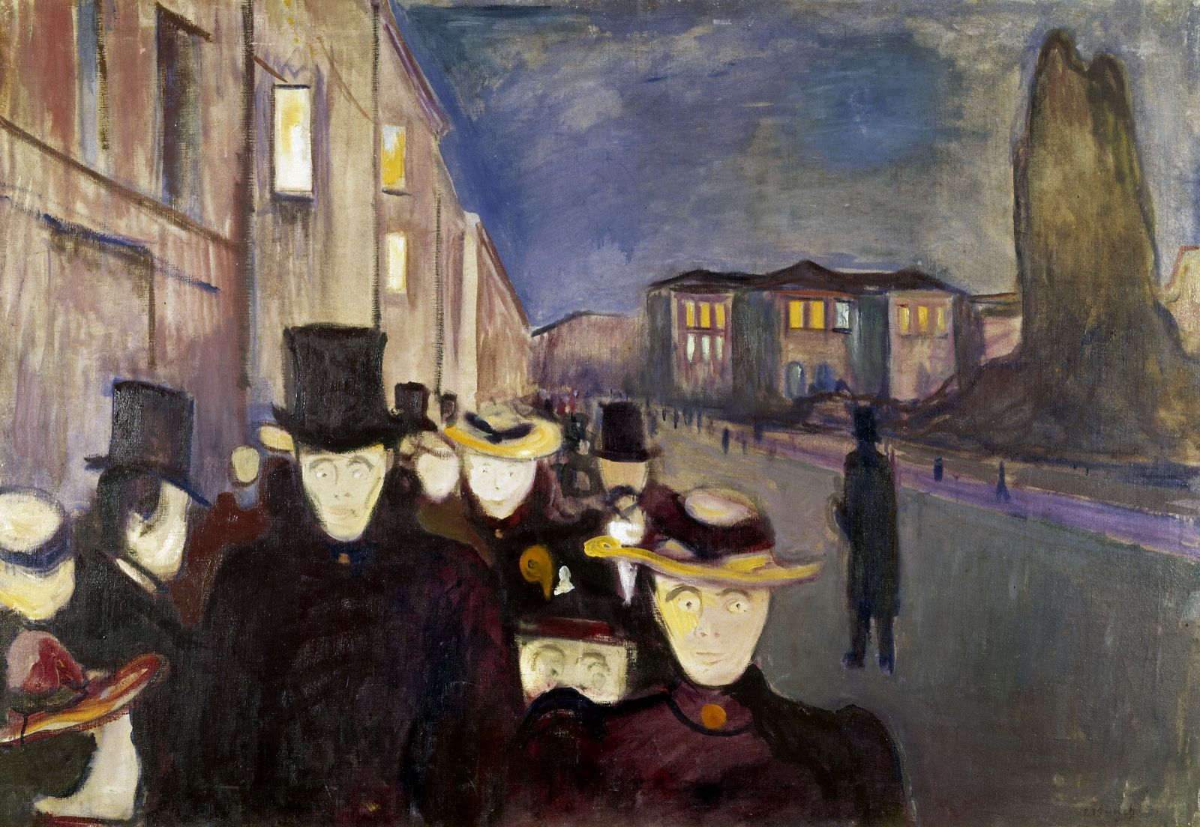
The Burial of the Dead
The framework for the whole poem is given by references to sterility and fertility.
These images are inspired by the relations between ancient fertility myths and rituals of early christianity and by the medieval romances of the Holy Graal
«The Burial of the Dead» is the first section and contains the main themes.
The spring is seen as a “cruel season”
that breaks the illusion of safety
and protection created by the winter.
The contrast aridity/fertility is established
with images which describe
a fragmented and sterile world.
« April is the cruellest month, breeding Lilacs out of the dead land, mixing Memory and desire, stirring Dull roots with spring rain. Winter kept us warm, covering Earth in forgetful snow, feeding A little life with dried tubers. »
«Son of man,
You cannot say, or guess, for you know only
A heap of broken images, where the sun beats,
And the dead tree gives no shelter, the cricket no relief, And the dry stone no sound of water. »
They are modelled on damned souls of Dante’s Inferno.
At the stroke of nine a procession of employees without identity, dragging along the London Bridge towards the heart of productivity: a river of undead who evokes
gloomy images of death.
« Unreal city, Under the brown fog of a winter dawn, A crowd flowed over London Bridge, so many I had not thought death had undone so many. Sighs, short and infrequent, were exhaled, And each man fixed his eyes before his feet. »
E. Munch, Evening on Karl Johan Street

Slide 7
Power point created by:
Chiarenza Concetto, Consolo Valeria, Di Mauro Laura, Magrì Enrico, La China Janice
Classe QUINTA sez. B
A. S. 2016 – 2017
Sources: A. Cattaneo – D. De Flavis, Millenium, Signorelli

