Slide 1
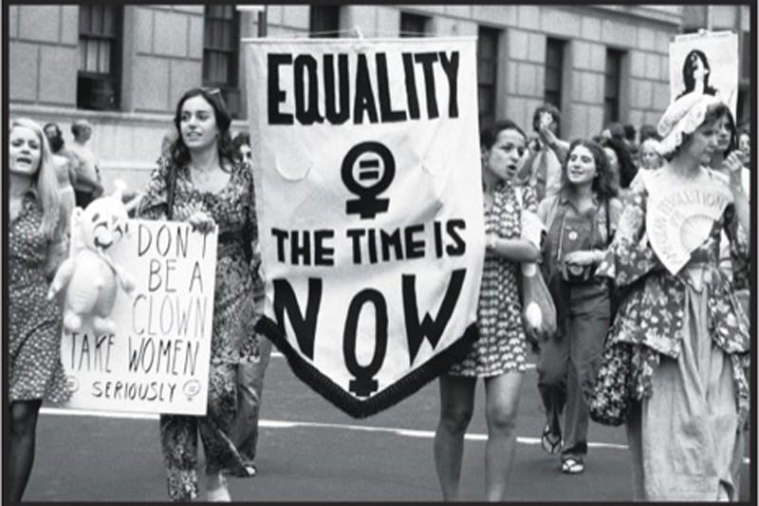
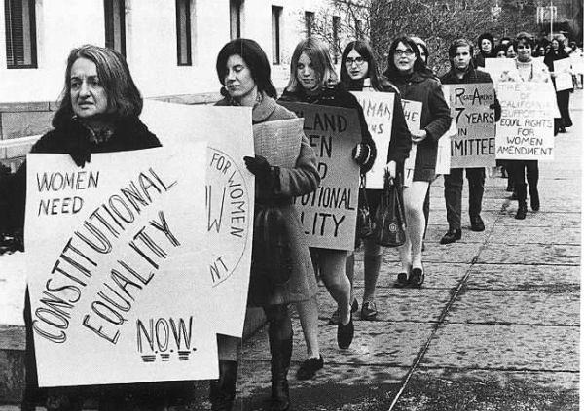
The Woman Question:
Emily Bronte and Virginia Woolf

Slide 2
XVII-XIX century Woman question
MARY WOLLESTONCRAFT
her «A vendication of the rights of woman» (1798) was considered the first feminist pamphlet.
XVII-XVIII
Major change in the direction of European society.
IDE
OLOGI
EARLY XIX CENTURY
advance of middle class
Worst conditions for women:
Rigid sexual and social behaviour of Victorian standards
IDEOLOGICAL
Enlightenment:
all human beings had the same rights.
SOCIAL
Industrial revolution:
Women were equal to men in money-earning power.
Family came to be challenged by degree
Husband considered as a tyrant
END OF XIX CENTURY
Women could study and take a degree at twelve university colleges
First petitions asking for women’s suffrage since 1840
MID XIX CENTURY
Things began to change
(J. S. Mill, «The subjetcion of women», 1869)
First step:
Foundation of colleges for women
Second step:
Married Women’s property act (1882)
Women allowed by law to own property after marriage
Woman didn’t get the right to vote until 1918

Slide 3
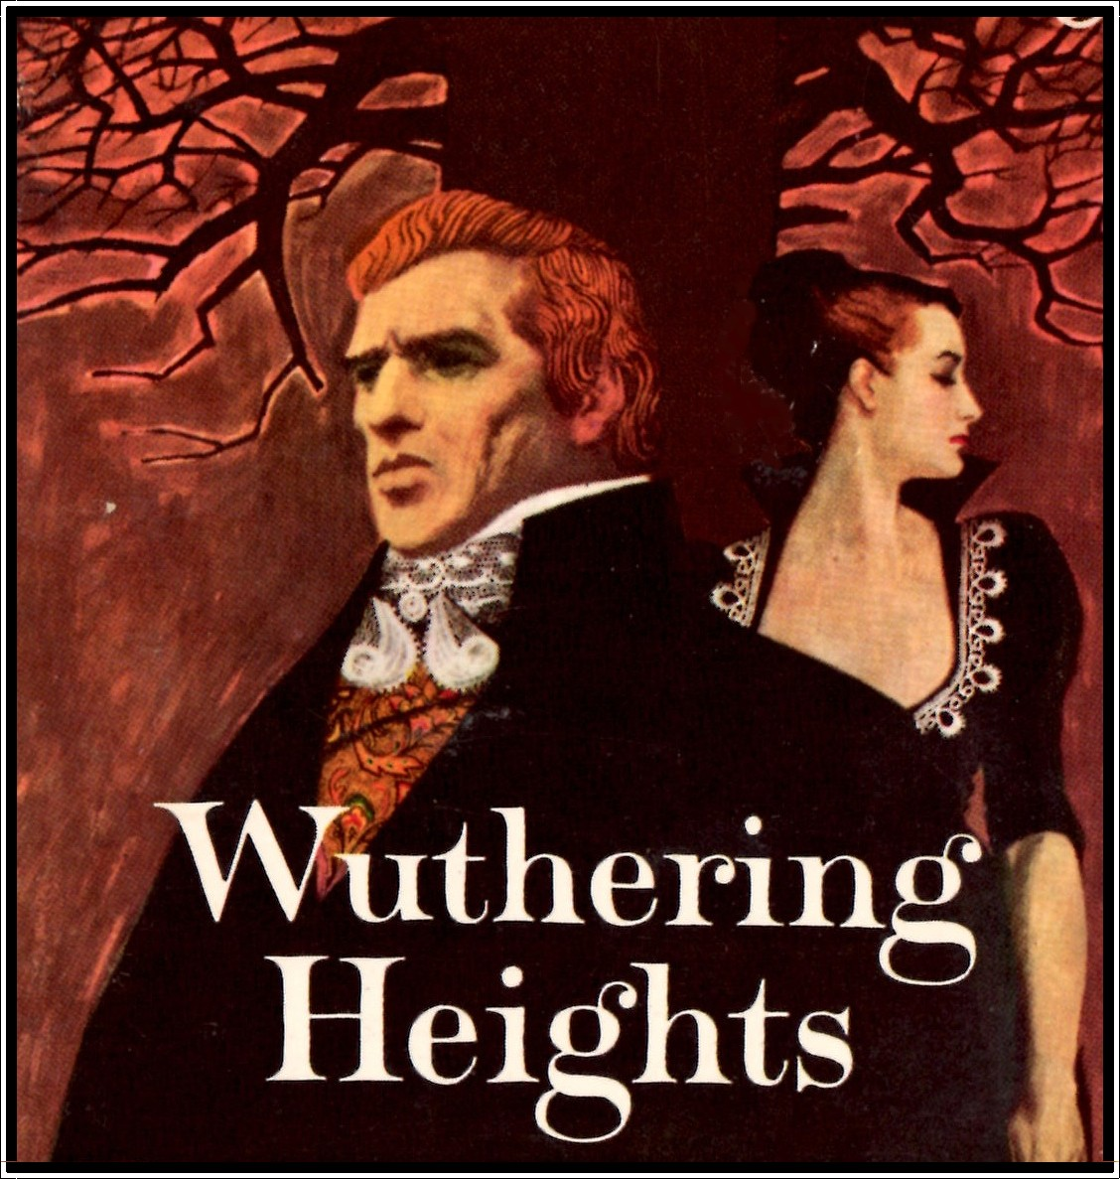
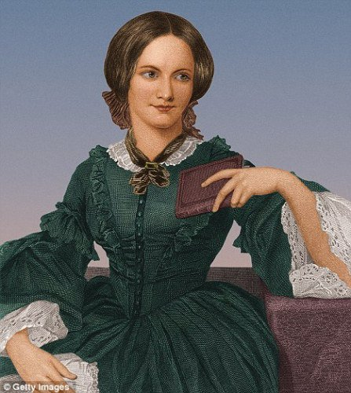
Emily Bronte
1818-1849
Both of her parents had Celtic origins:
this meant for her a background of fantastic story-telling.
She lived in the desolate Yorkshire moors:
In this enviroment her imagination was constantly stimulated by nature.
Emily’s novel and poems:
Passion and feelings;
Violent impulse to break through life’s conventions;
Desperate need for a freer world of the spirit;
Power of imagination

Slide 4
Wuthering heights
(1847)
« a modern love story »
Wild spirit;
For the first time in Victorian literature there is a passionate love;
Exaltation of feelings over reason and of a mystical union with nature.
Two narrators: complex shifting of the point of view.
It describes the life-long passion between Heathcliff, a dark romantic hero, and Catherine Linton, a passionate young woman oppresed and divided by social conventions.
Setting:
«So he shall never know how I love him: and that, not because he's handsome, Nelly, but becouse he's more myself than I am. Whatever our souls are made of, his and mine are the same; and Linton's is as different as a moonbeam from lightning, or frost from fire»
Wuthering Heights
(up on the moor)
Trushcross Grange
(in the valley)
Home of unrestrained passion and istinct.
Home of social convention

Slide 5
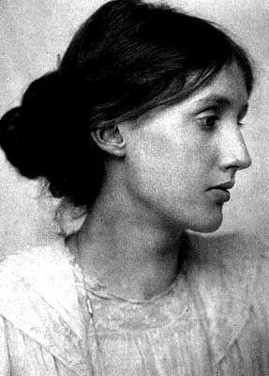

XX century Women’s road to equality
First step:
The role of women, their psychological and intellectual characteristics and their relationship were amply debated.
Rise of the women’s movement:
Since 1945 a new feminism began to form and express itself, especially in the USA.
Work which marks the beginning of woman consciousness:
A room of One’s Own (1929) by Virginia Woolf stresses the necessity for women to gain economic and intellectual freedom.
Founding of NOW
National organization for women
«Lock up your libraries if you like; but there is no gate, no lock, no bolt that you can set upon the freedom of my mind.»

Slide 6
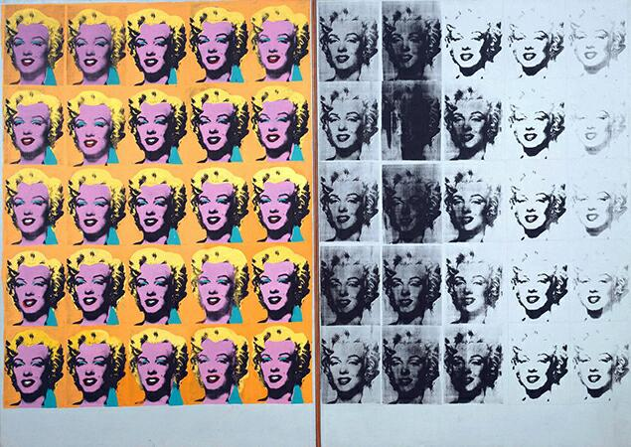
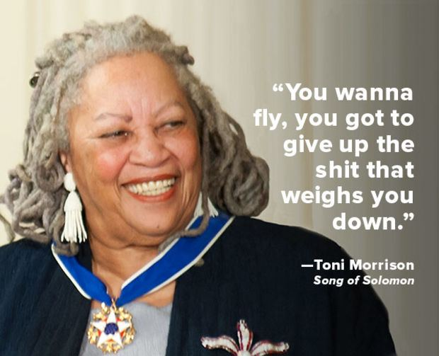
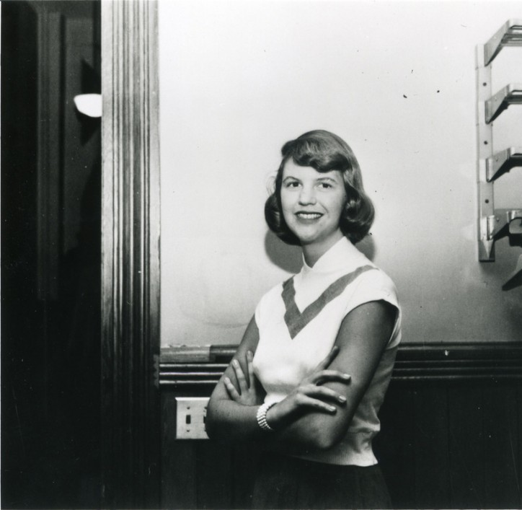
Original women’s voices:
Sylvia Plath
The American poet became a charismatic figure for the feminists of the 60s and 70s for her tragic death (suicide) that made her a symbol of the tensions and the sufferings to which many women are subjected in society.
Andy Warhol, Marylin Diptych (1962)
Sex simbol:
In the same years, women were becaming sex symbols in advertising, the cinema and the media.
The actress Marilyn Monroe became the iconic rapresentation of the woman in consumer society.
Toni Morrison
The first black woman to be awarded the Noble Prize for literature.
Sylvia Plath
Her novel «Beloved» combines the issues of race and gender in American society

Slide 7
Realized by:
Bruno Agnese Lucia
Magistro Damiana
Sciacca Maria
Scuderi Manuela
Anno Scolastico 2016/2017
Classe V sez B scientifico
Sources:
Cattaneo-De Flaviis,Millennium, Signorelli;
Google images.

